Slide 1
Agent based models of debt and collapse
By Tobias Holm
And supervised by Kim Sneppen

Slide 2
Why econophysics?
Or: Are physicist the most arrogant scientists?
Presumptuous I can do better than economists?
… So, what are the economists doing?

Slide 3
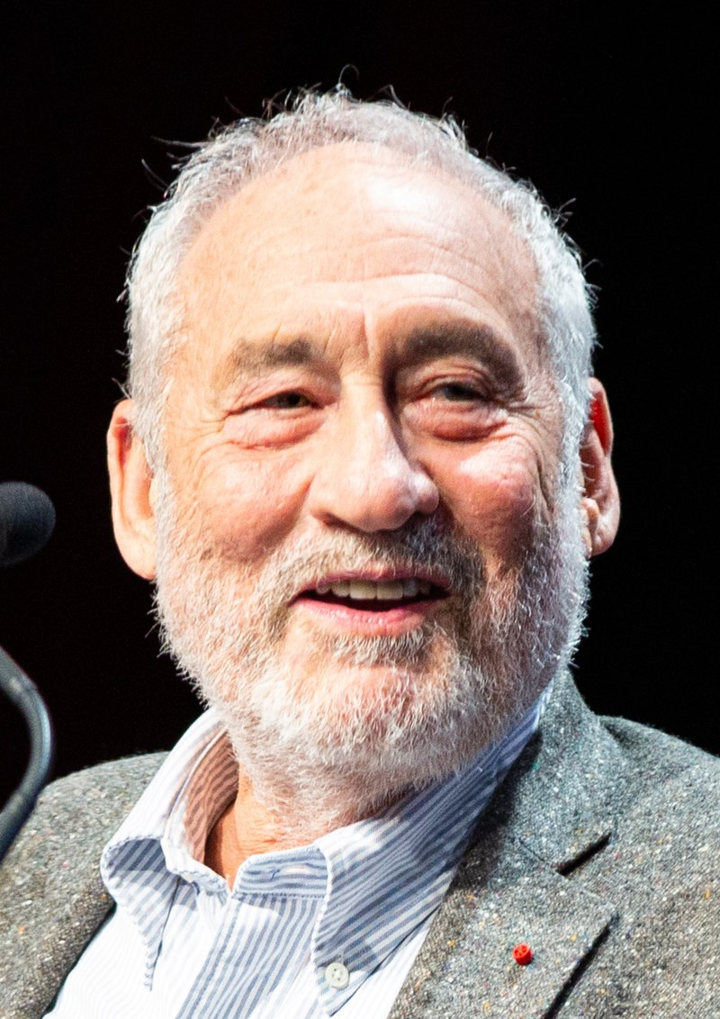
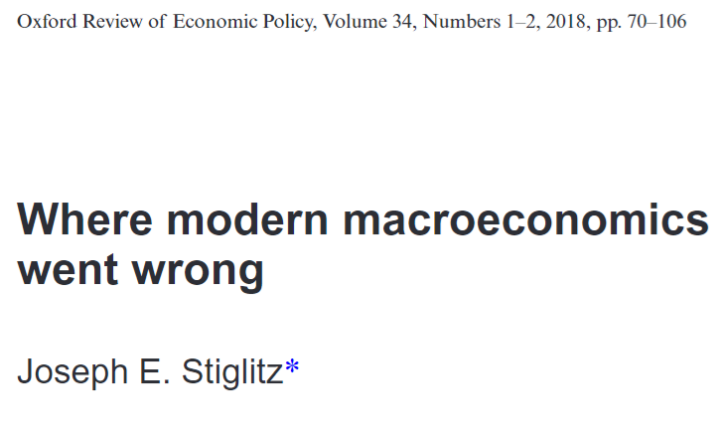
Why econophysics?
Or: Are physicist the most arrogant scientists?
… So, what are the economists doing?
J. E. Stiglitz
Photo by Jérémy Barande
All quotes and equations from [Stiglitz18].
Notes:
Don’t read all the quotes out, just mention things like:

Slide 4
Why econophysics?
Or: Are physicist the most arrogant scientists?
In short: Critiques complexity of existing models
“What we seek from a ‘benchmark model’ in macroeconomics is not always clear. [He] suggests that we should be looking ‘for a simple model which we could teach to graduate students to provide them with a less misleading framework […]” (Bold by me)
J. E. Stiglitz
Photo by Jérémy Barande
“The models should capture what we believe are the macro-essential characteristics of the behavior of firms and people, and not try to capture all relevant dynamics. Only then can they serve their purpose, remain simple enough, and provide a platform for theoretical discussions.” (Bold by me)
“And with so many parameters, macro-econometrics becomes little more than an exercise in curve fitting […]” (Bold by me)
All quotes and equations from [Stiglitz18].
Notes:
Don’t read all the quotes out, just mention things like:

Slide 5

Why econophysics?
Or: Are physicist the most arrogant scientists?
J. E. Stiglitz
Photo by Jérémy Barande
… I may be presumptuous, but at least I don’t have >15 parameters
All quotes and equations from [Stiglitz18].
Notes:
Don’t read all the quotes out, just mention things like:

Slide 6
Fisher’s debt-deflation feedback model
Shock
Debt Liquidation
Disturbed interest rates
Distress Selling
Hoarding, slower circulation
Loans paid off (lower money supply)
Pessimism
Deflation (fall in prices)
Fall in business output
Fall in business worth
Notes:
Original. Simplified. My interpretation/implementation.

Slide 7

What is a company?
× N
Production capacity p
(Employees, equipment etc.)
Debt d
(Negative d = money)
Confidence β
Notes:
N companies, each with two variables p and d and a parameter beta

Slide 8
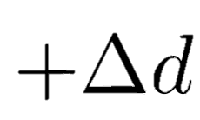
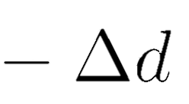


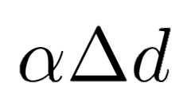
How do companies interact?
Transfer money
Increase production
Transactions convert debt to production capacity
Notes:
Jysk needs some new computers, so they give money (increases debt) to IBM, and in return gains increased production capacity

Slide 9
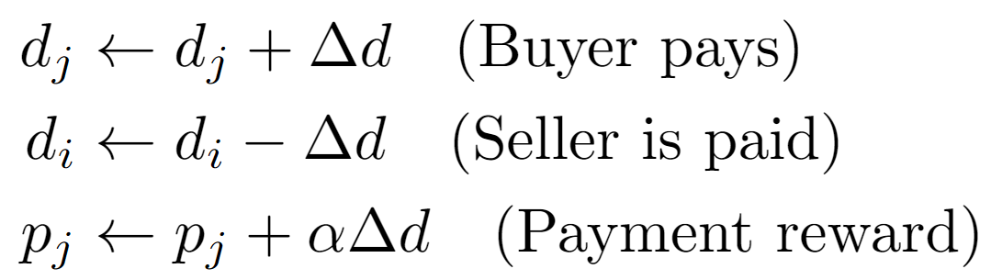
How do companies interact?
Transfer money
Increase production
Notes:
Company j buys from i. Takes loan if necessary. Converts spent money into production capacity

Slide 10

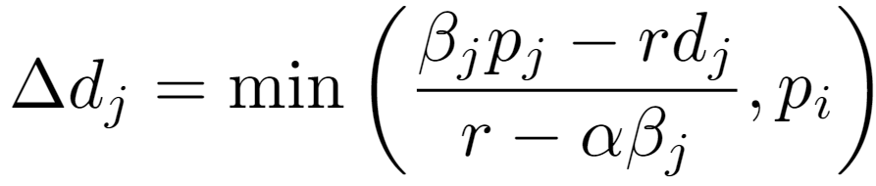
How much debt should you take?
Can’t buy more than seller can produce
Variable reminder
p: production capacity
d: debt
β: Confidence
α: d to p efficiency
r: interest rate

Slide 11
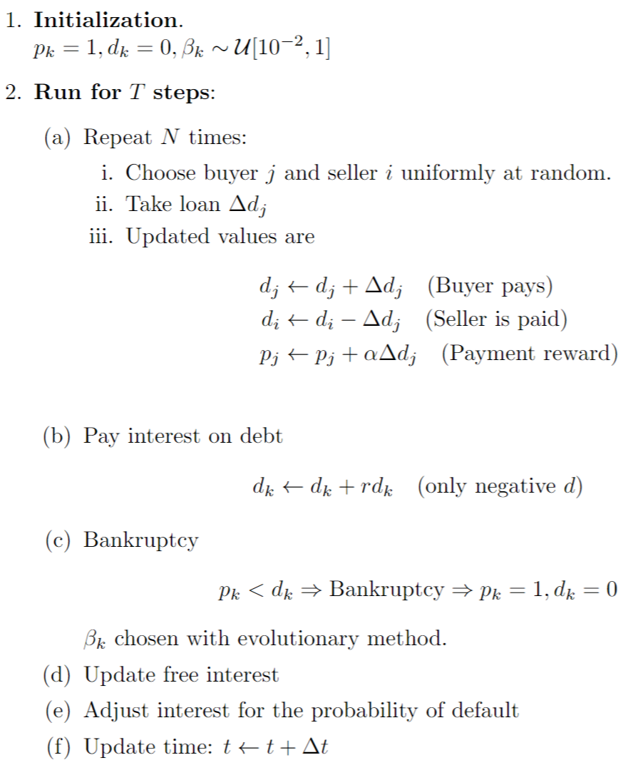
Transaction
Variable reminder
p: production capacity
d: debt
β: Confidence
α: d to p efficiency
r: interest rate

Slide 12
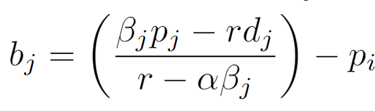
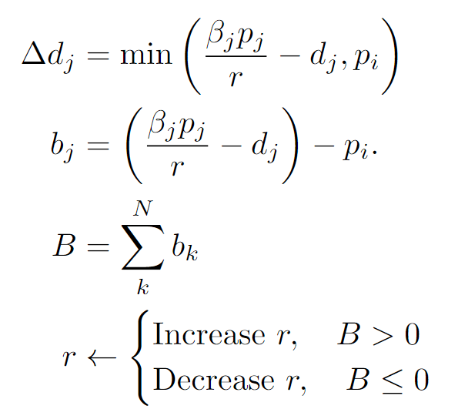
Interest update
If companies can take larger loan than needed, increase interest rate and vice versa.
Variable reminder
p: production capacity
d: debt
β: Confidence
α: d to p efficiency
r: interest rate

Slide 13
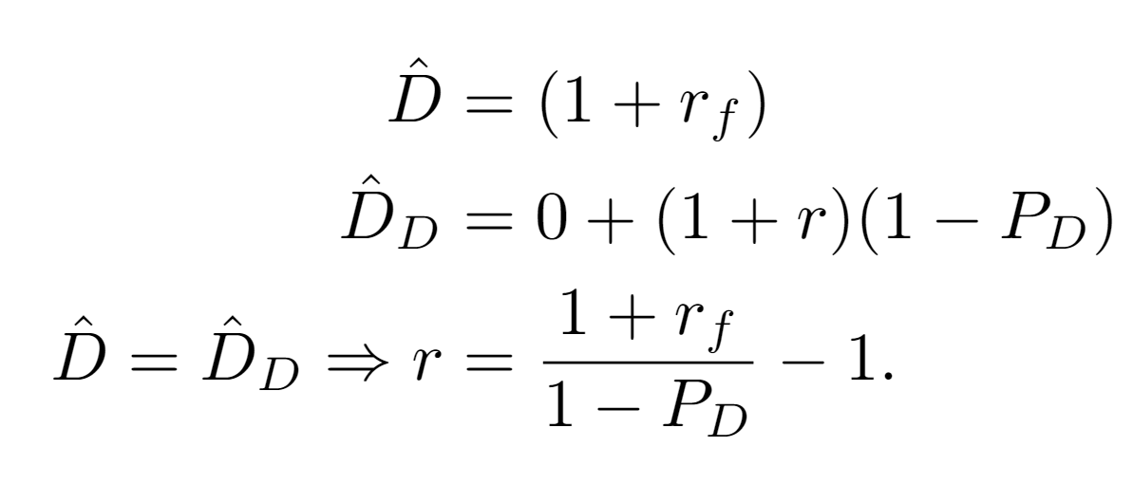
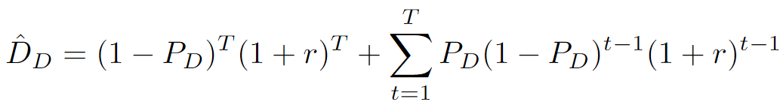
Adjusting r for default
One step equation
T-step equation
No default
Default at time t

Slide 14
My take on Fisher’s feedback model
Shock
Debt Liquidation
Less money
Disturbed interest rates
Distress Selling
Hoarding, slower circulation
Loans paid off (lower money supply)
Slower growth
Lower β
Pessimism
?
Deflation (fall in prices)
Variable reminder
p: production capacity
d: debt
β: Confidence
α: d to p efficiency
r: interest rate
Lower production capacity
Fall in business output
Fall in business worth
Notes:
Original. Simplified. My interpretation/implementation.

Slide 15
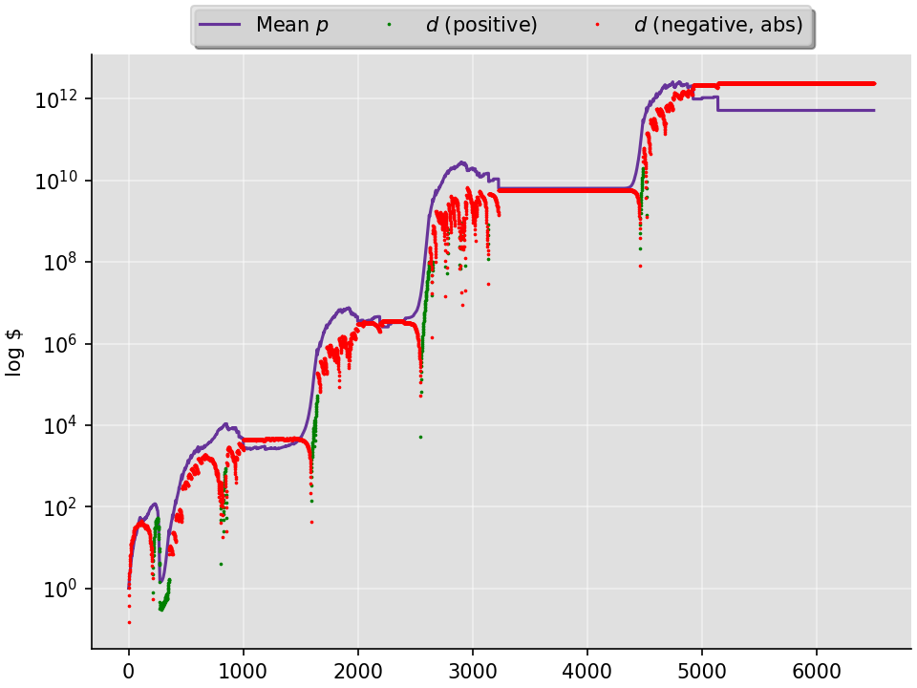
Economy development
alpha=0.15
N=125

Slide 16
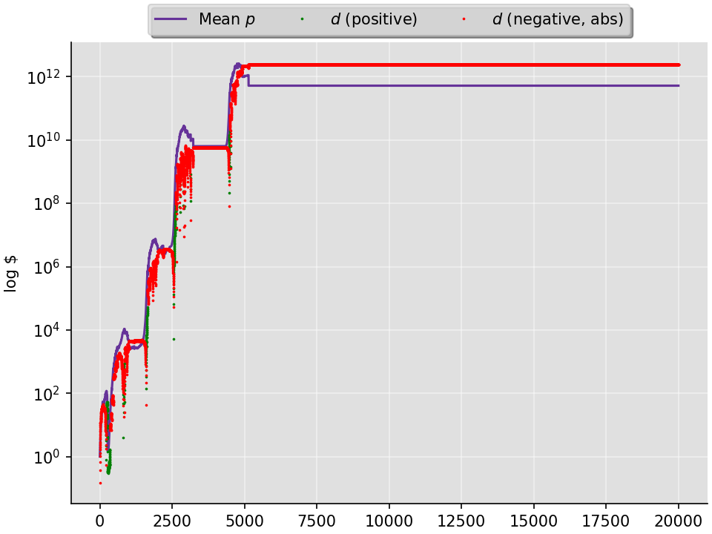
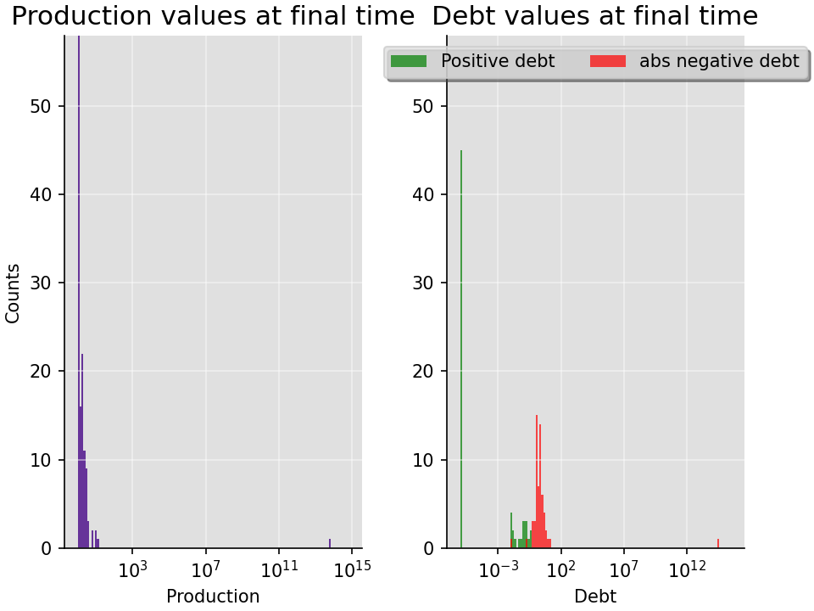
Economy development (Full story)
alpha=0.15
N=125

Slide 17
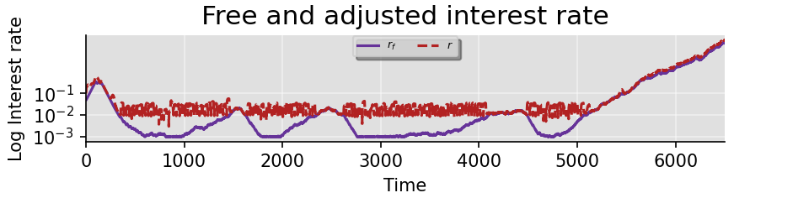
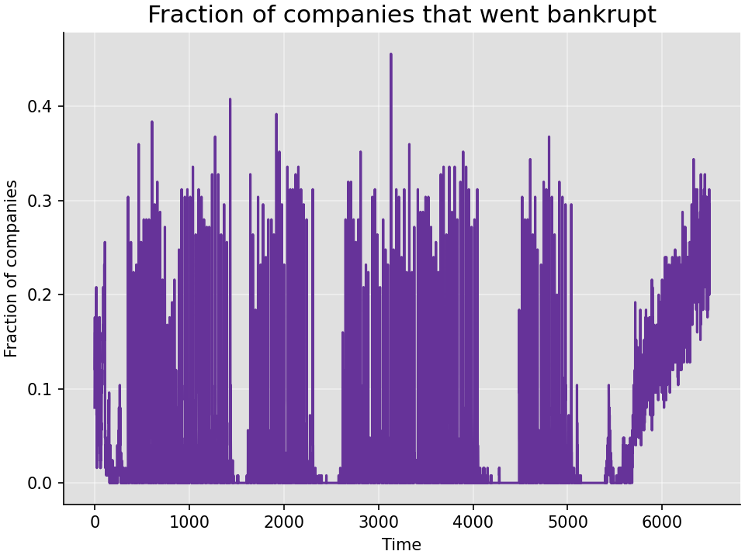
Boom period: High interest

Slide 18
Difficulties
Interest update – Adjusted ~ constant
One company dominates => Stagnation
Too many bankruptcies, leading to low beta

Slide 19
References
[Stiglitz18] Stiglitz, J. E. (2018). Where modern macroeconomics went wrong. Oxford Review of Economic Policy, 34(1-2), 70-106.

